Slide 1

Zomato Restaurants Expansion
By Rucha Patil

Slide 2
Introduction
Zomato is a leading global food delivery service, is exploring new frontiers to open restaurants, aiming to leverage data-driven insights for optimal decision-making. Our objective is to analyze existing data to pinpoint the best locations and strategies for opening new restaurants.
Objectives:
Identify Potential Areas for Expansion.
Examine trends in cuisines, customer preferences, and competitive Places to guide strategic decisions.
Identify the optimal price ranges and cost structures to ensure profitability while maintaining customer value.

Slide 3
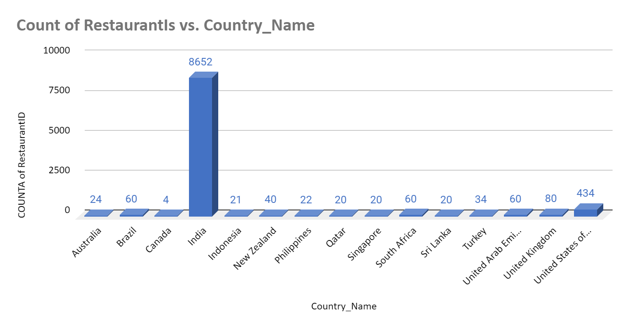
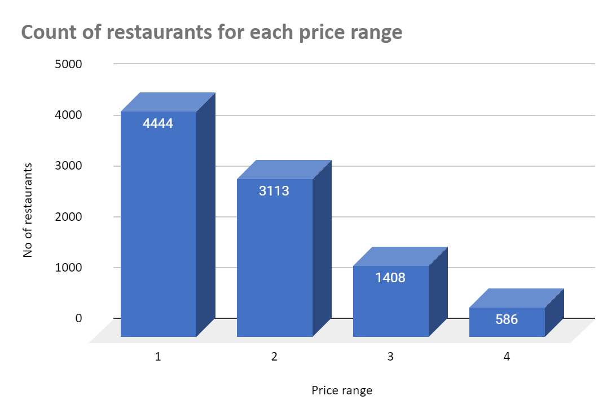
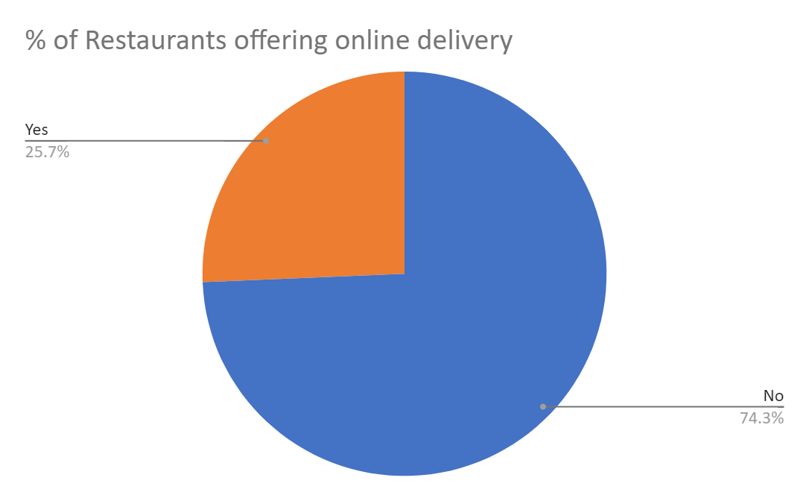
Data Overview
Number of restaurants: This data includes total 7433 number of restaurants across the 15 different countries.
Price Ranges: This shows the restaurants with budget-friendly, Mid-range, Expensive. From the data 4444 restaurants are budget friendly( price range 1), 4521 are of mid range(price range 2-3) and 586 are expensive(price range 4)
Cuisine types: There are 1826 types of cuisines across all countries.
Delivery option: From overall data 25.66% of restaurants offering online delivery.
Data cleaning: Data contains missing values, so we cleaned it by filling the relevant values in empty cells.

Slide 4



Analytical approach and tools
Descriptive Statistics: Calculated basic statistics like total restaurants, number of restaurants per country/city, price range distribution, etc.
Data Cleaning: Identified and addressed missing values in the "Cuisines" column.
Filtering and Segmentation: Segmented data by country, price range, online delivery availability, and rating to identify trends.
Conditional Formatting: Highlighted rows in cities with low restaurant count, suggesting potential for new openings.
Formulas and Functions:Used functions like COUNTIFS, VLOOKUP, XLOOKUP, AVERAGEIFS, CONCATENATE, CORREL, and array formulas to perform calculations and data manipulation.
Visualization Techniques: Created charts and tables to represent the distribution of restaurants across various aspects (price range, countries, ratings).

Slide 5
Analysis of objective questions
Here's a breakdown of the key findings based on the questions:
The data consists of two tables: "Raw Data" and "Country Description."
"Raw Data" contains information about the restaurants, including 20 attributes like Restaurant ID, Name, Location details (City, Address, etc.), Cuisine type, Currency, Online delivery status, Price range, Ratings, etc.
"Country Description" is a smaller table with just Country Code and Country Name.
Total of 16 categorical columns were found across both tables.
388 total number of restaurants in India with a price range 4.
Custom price column combining currency and cost information like R$55, Œ£25, Rs.3000
Total count is 1685 for restaurants listed that do not offer online delivery, are in the lowest price range, and have an average cost for two people less than or equal to 250 Indian Rupees

Slide 6
Analysis of objective questions Cont..
India has dominance presence as it includes 8625 number of restaurants, this signifies a intense competition for new restaurants.
Brazil, South Africa, and the United Arab Emirates all have a notable presence with 60 restaurants each.
The United States has a considerable number of restaurants (434), followed by the United Kingdom (80).
Canada and other countries have a smaller number of restaurants (under 50).

Slide 7
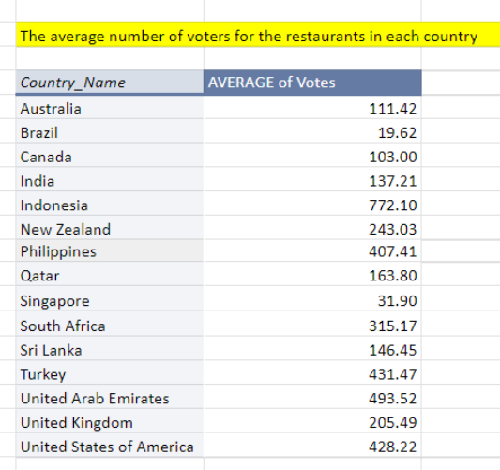
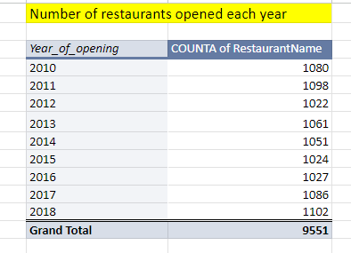
Analysis of objective questions Cont..
Indonesia has a significantly higher average votes(772.10)
Philippines, Turkey, United Arab Emirates, and South Africa countries have a relatively high average number of voters, suggesting active user participation in reviewing restaurants.
Countries like India, the United States, and the United Kingdom show a moderate level of voter engagement.
Australia, Brazil, Canada, and Singapore have a lower average number of voters
There is a relatively stable growth pattern in restaurant openings, with the count fluctuating between 1022 and 1102 restaurants per year across the eight years.
There's a slight upward trend, with 2018 showing the highest number of openings (1102).

Slide 8
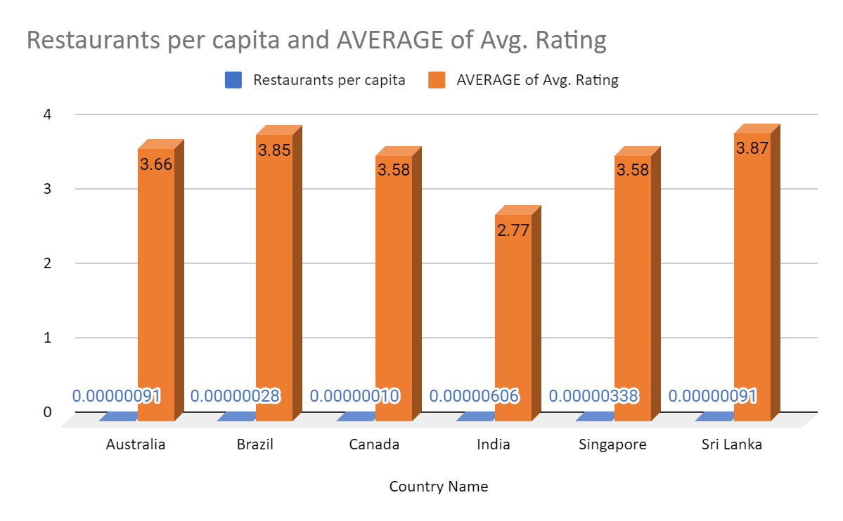
Insights from Subjective Questions
Suggested countries with less competition:
Identified Countries are India, Singapore, Australia, Brazil, Canada, Sri Lanka as interesting options.
Above listed countries have restaurants per capita less than 0.000004 which indicates markets with potentially less competition.
Also the restaurants present in those country got the ratings less than 4 which indicates markets with potentially less competition.

Slide 9
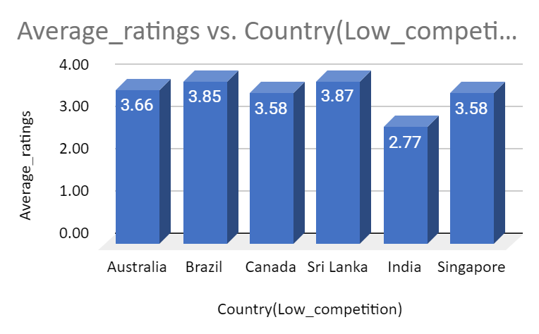
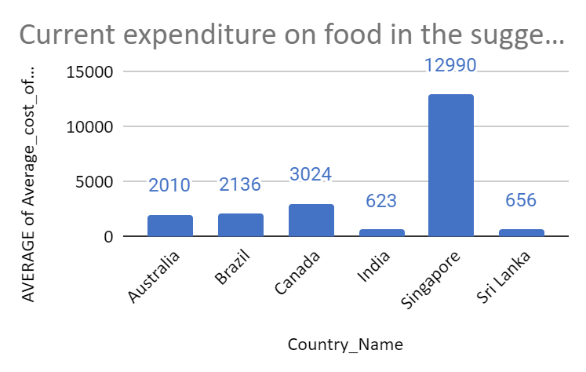
Insights from Subjective Questions
Current quality of ratings for suggested countries
Current expenditure on food for suggested countries
India (INR 623) is the most budget-friendly option on the list.
Similar to India, Sri Lanka (INR 656) offers a relatively affordable dining experience for two.
Food costs in Brazil (INR 2136) are moderately higher than India and Sri Lanka.
Budgeting for food expenses will be more significant in Canada (INR 3024.
Singapore (INR 12990)is the most expensive option on this list.
The chart suggests that countries with average ratings below 4 might present less competition and more opportunities for opening new restaurants.

Slide 10
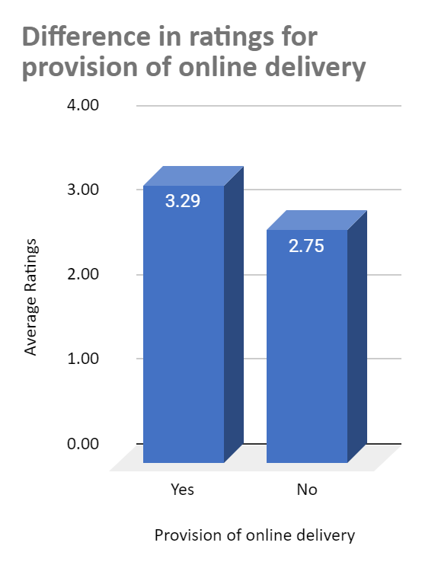
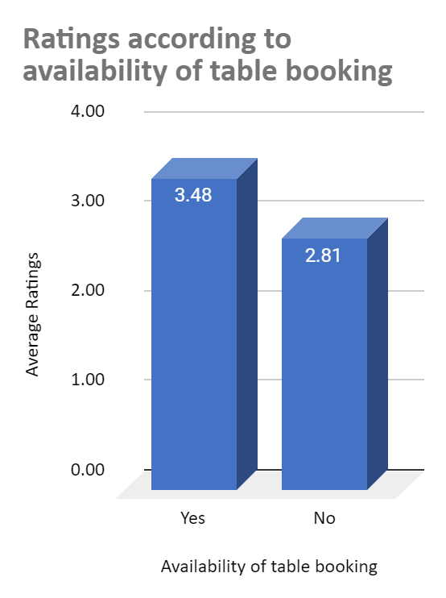
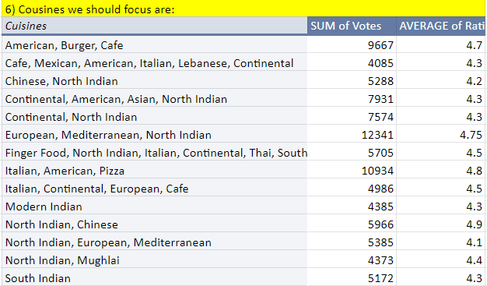
Insights from Subjective Questions
Provision of online delivery and table booking
Popular cuisines:
Above cuisines appear frequently with both high total votes which indicates popularity and high average ratings.
For newer restaurants we must focus on this 15 cuisines as their ratings shows higher customer satisfaction.
Restaurants offering online delivery and table booking options tend to have higher customer ratings compared to those without.
This suggests that convenience plays a significant role in customer satisfaction within the restaurant industry.

Slide 11
Strategic Recommendations
Focus on Convenience: Implement online delivery and table booking services for all new restaurants. As this suggests that convenience plays a significant role in customer satisfaction within. By implementing these features,we can potentially improve ratings for our new restaurants and cater customers.
Target Potential Markets: Research the suggested countries India, Singapore, Australia, Brazil, Canada, Sri Lanka to expand new restaurants as we found that there is lower competition and room for growth (fewer restaurants, lower ratings). Also look for cities with fewer restaurants, suggesting potential demand. Identify cities with lower average ratings, indicating less established competition and areas where your restaurants can make a positive impact.

Slide 12
Strategic Recommendations
Explore Popular Cuisines: Develop menus featuring popular cuisines like American, North Indian, Continental, and Italian, for new restaurants. As we analysed a connection between high votes and customer satisfaction (high ratings) for this type of cuisines. Also explore opportunities to create fusion concepts or introduce innovative dishes within these popular categories to stand out from the competition.
Price Strategically:We observed a moderate positive correlation between price and ratings. While higher prices might suggest higher quality to some customers.
By implementing these recommendations, we can increase our chances of success when expanding new restaurants.

Slide 13
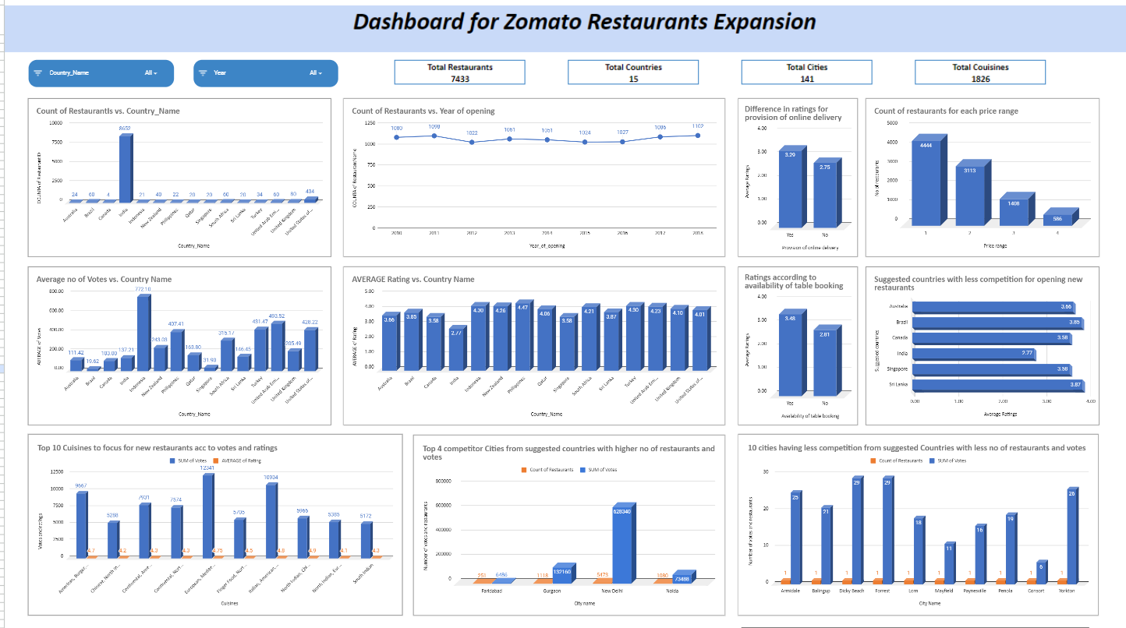
Dashboard and visualizations

Slide 14

Conclusion
In conclusion, the data-driven approach recommends focusing on underserved cities within identified countries such as India, Singapore, Australia, Brazil, Canada, and Sri Lanka, which present opportunities with lesser competition and the potential for higher customer satisfaction. Incorporating essential services like online delivery and table booking is crucial, as data indicates these features are positively correlated with higher customer ratings. Prioritizing popular cuisines that have shown to attract higher votes and ratings, such as American, Burger, Cafe, Chinese, and North Indian, etc will cater to customer preferences and enhance the restaurant's appeal.

Slide 15
References:
Zomato market data 2023
Spreadsheet software (Google Sheets)
Cool article to do effective storytelling by presentationload

